Slide 1

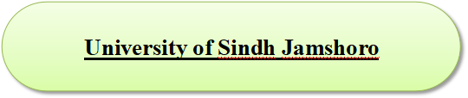
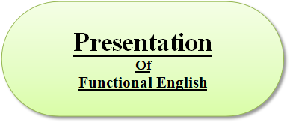

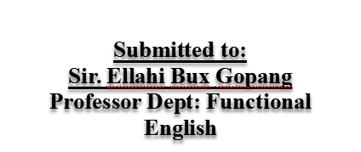
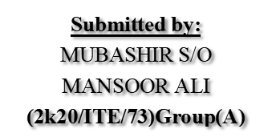
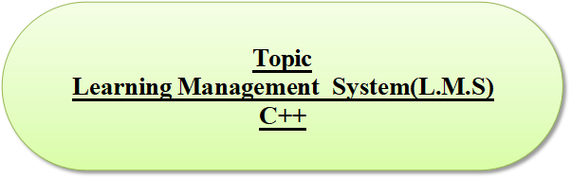

Slide 2
Introduction:
The reading demands of university study are not easy. Unfortunately, however, it is all too common for students to pay little attention to their own approaches to reading, that is, how they read, and how they can improve the effectiveness and speed of their reading.
This helpsheet provides extensive reading advice. Furthermore, the helpsheet provides reading tips that are specific for particular text types and for the purposes you may have.
Before you read this advice, you may find it worth reflecting on the nature of the reading that you at universtiy.

Slide 3
This may help you consider which of the following tips might be particularly useful.
The following section may help you do this.
Reading Skills:
Reading is an important part of learning English. This guide to how to improve your reading skills will help you improve reading by using skills you use in your own language.
Reading skills refer to the specific abilities that enable a person to read with independence and interact with the message. Students at the university do a lot of reading unlike in secondary school. Some tips to help in having good reading skills are active reading and styles of reading.

Slide 4
The four main types of reading skills Techinques are the following:
Scanning
Skimming
Intensive
Extensive
Scanning:
Scanning refers to the ability to locate specfic or particular piece of information or facts as quickly as possible. We use scanning on schedules, meeting plans, etc. in order to find the specific details you requrie.
For Example:
A train / airplane schedule
A word in a dictionary
A specific point or fact in a text

Slide 5
Skimming:
Skimming is reading quickly to gain a general idea. Skimming may allow you to ‘read’ up to 1000 words a minute.Skimming helps you identify whether or not to continue reading, what to read carefully, and where the best place is to begin. Skimming an academic text immediately before you read it carefully can help you consider what you already know and can help you develop a purpose for reading.An initial skim can also help maximise your interest in the text and your understanding and reflection on the material.
For Example:
Newspaper (quickly to get the general news of the day)
Magazines (quickly to discover which articles you would like to read in more detail.
Business and Travel brochure (quickly to get informed)

Slide 6
Extensive :
Involves learners readinng texts for enjoyment and to develop general reading skills.
It is used to obtain a general/overall understanding of a subject and includes reading longer texts for pleasure, as well as business books.
Use extensive reading skills to improve your general knowledge of business procedures. Not necessaey to understand each word.
For Example:
Story books
The latest marketing strategy book
A novel you read before going to bed

Slide 7
Intensive:
Intensive reading is used on shorter texts in order to extract specific informatio.It includes very close accurate reading for detail. Use intensive reading skills to grasp the details of a specific situationn. In this case, It is important that you under each word , number or fact.
For Example:
A Book keeping report
An insurance claim
A contract

